Slide 1



Mental Health Campaign for DFTA
View in Power BI
Last data refresh:
5/7/2021 6:55:57 AM UTC
Downloaded at:
5/7/2021 8:18:12 AM UTC

Slide 2
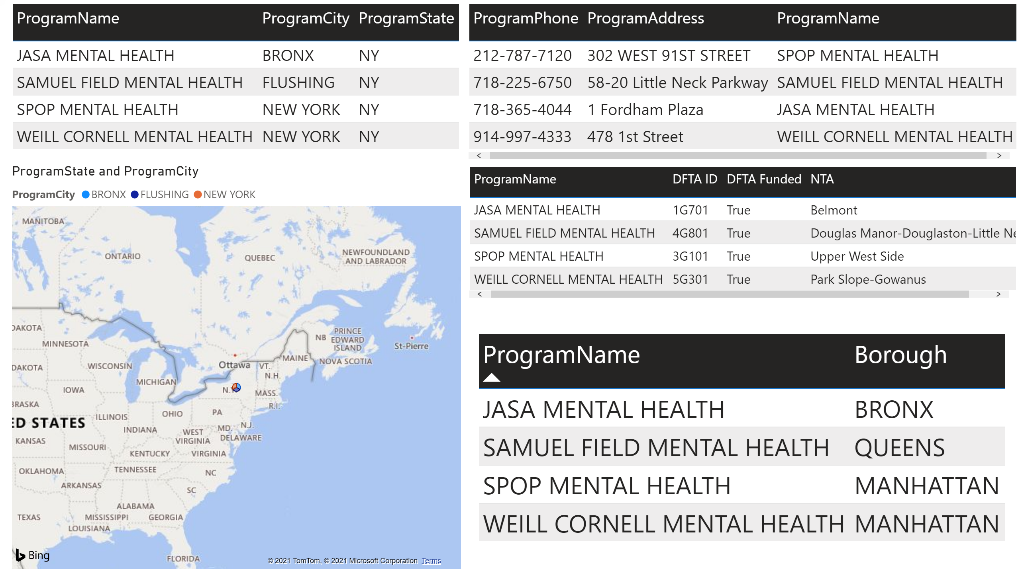
Details and Geographies
Notes:
tableEx
Program Details
map
No alt text provided.
tableEx
Contacts
tableEx
No alt text provided.
tableEx
Borough

Slide 3
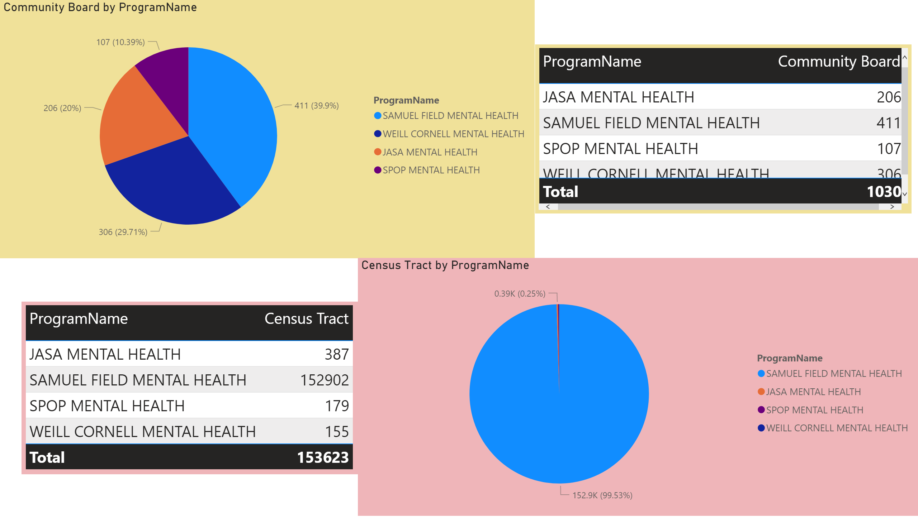
Estimates
Notes:
pieChart
No alt text provided.
tableEx
No alt text provided.
pieChart
No alt text provided.
tableEx
No alt text provided.

Slide 4
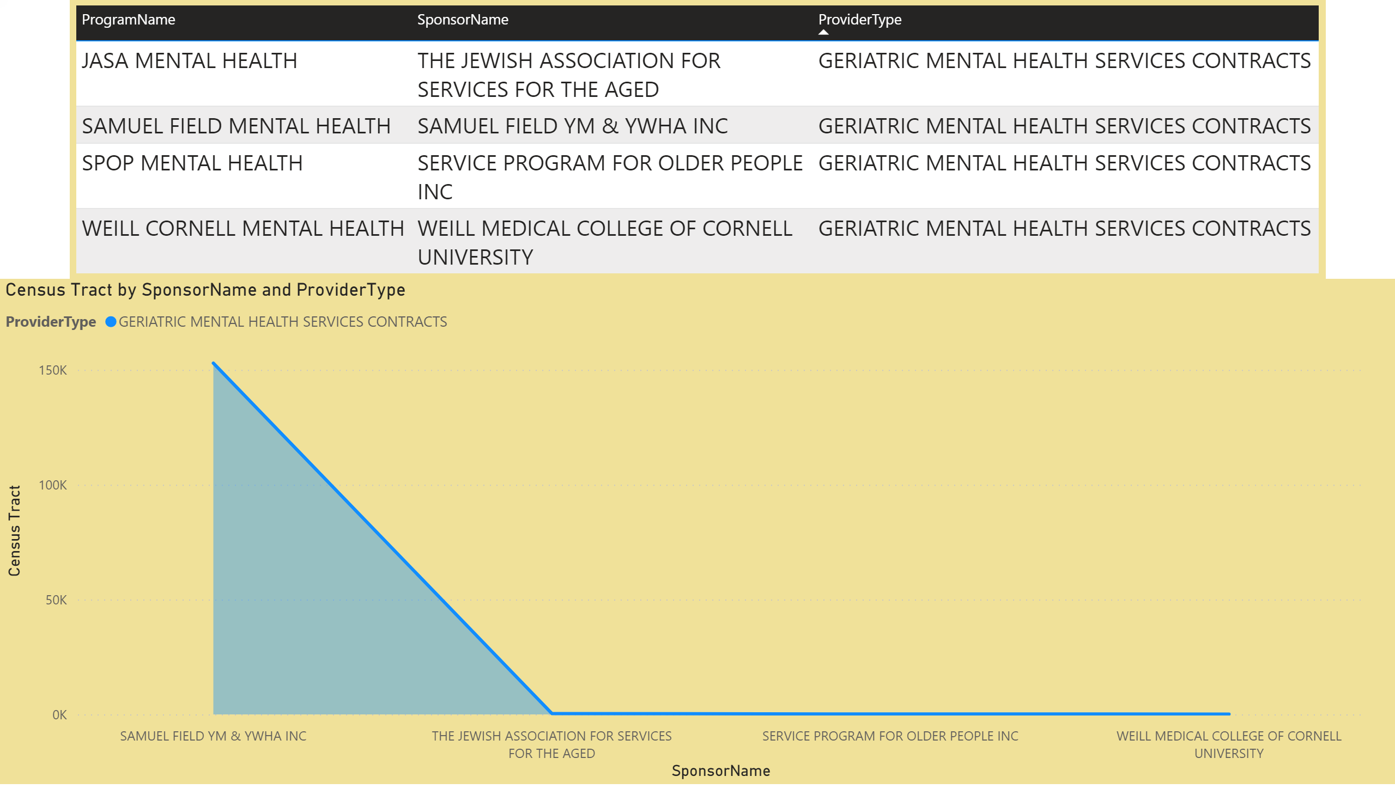
Providers and Census
Notes:
tableEx
No alt text provided.
stackedAreaChart
No alt text provided.

Slide 5
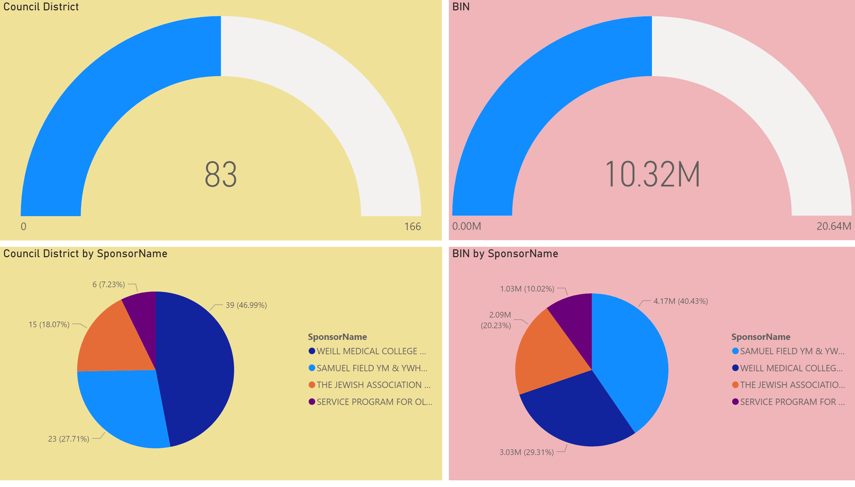
Sponsorship Targets
Notes:
gauge
No alt text provided.
pieChart
No alt text provided.
gauge
No alt text provided.
pieChart
No alt text provided.

Slide 6
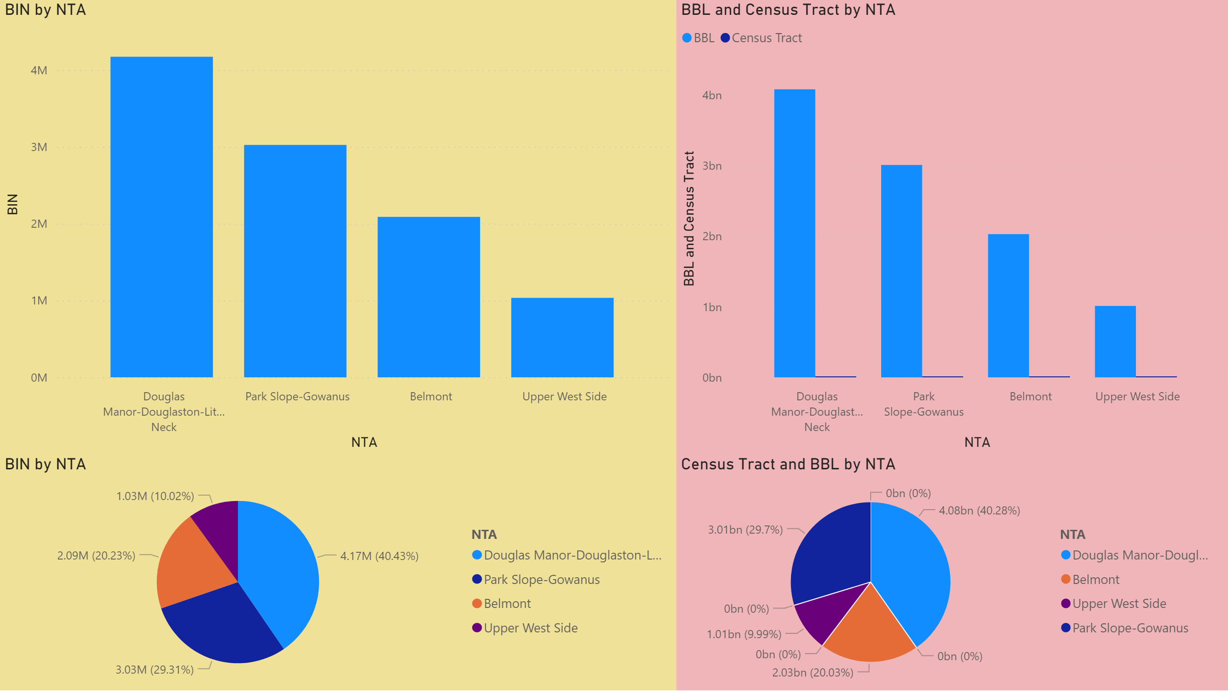
Funds vs Census
Notes:
clusteredColumnChart
No alt text provided.
pieChart
No alt text provided.
clusteredColumnChart
No alt text provided.
pieChart
No alt text provided.

